Slide 1
Predicting Spotify Song Popularity Scores

Slide 2
Problem Statement
What song characteristics, artists, & words used in titles contribute the most towards a song being more popular?
Can song attributes be used to predict the popularity of songs not yet released?

Slide 3
Uses of Analysis
Artists & bands can gain insight into how they can tailor/alter their music to be more popular
Recording labels & music producers can develop & release music that will result in more financial success for themselves & artists
More songs better suited to the tastes of the public will be created

Slide 4
Dataset
https://www.kaggle.com/yamaerenay/spotify-dataset-19212020-160k-tracks
Dataset used comes from Kaggle & was originally extracted from Spotify’s API
Data contains information about 170,000 songs released between 1921-2020
Numeric attributes & their values were created & assigned by Spotify

Slide 5
Variables Used
Acousticness: How acoustic a song is on a scale from 0-1
Artists: List of artists credited with production of a song
Danceability: How suitable a song is for dancing on a scale from 0-1
Duration: Length of a song
Energy: How energetic a song is on a scale from 0-1
Explicit: Binary variable based on whether a song contains explicit content
Instrumentalness: Likelihood the song contains vocals on a scale from 0-1

Slide 6
Variables Used
Liveness: Likelihood the song was a live recording on a scale from 0-1
Loudness: How loud a song is in decibels
Name: Title of the song
Popularity: How popular a song is on a scale from 0-100
Speechiness: How much spoken word is within a song on a scale from 0-1
Tempo: The pace of a song given by beats per minute
Valence: The amount of positiveness conveyed by a song on a scale from 0-1

Slide 7
Data Wrangling
Condensed dataset to include only songs released after 1990
Converted scale of ‘duration’ from milliseconds to minutes
Removed songs with a duration longer than 10 minutes

Slide 8
Initial Findings & EDA
Boxplots, histograms, & summary statistics to see distributions & frequencies of numeric variables can viewed in code
Correlation matrix & scatterplots used to see if numeric variables are correlated with ‘popularity’
None of the numeric variables have a significant correlation with ‘popularity’ individually
# of songs included per year ranges from 1756 songs from 2020 to 2000 songs from both 2017 & 2018
Average popularity of songs through the years ranges from a popularity score of 39.83 in 1990 to a score of 69.66 in 2019
Increasing trend overall

Slide 9
Initial Findings & EDA
50% of songs have a popularity score greater than 50, only 3% of songs have a popularity score equal to or greater than 75
Most frequently occurring song titles are ‘Home’, ‘You’, ‘Runaway’, ‘Stay’, & ‘Forever’
Most frequently occurring words in song titles are ‘the’, ‘you’, ‘feat.’, ‘me’, & ‘I’
The artists/bands with the most songs within the dataset are Taylor Swift, Eminem, Red Hot Chili Peppers, Nirvana, & Green Day

Slide 10
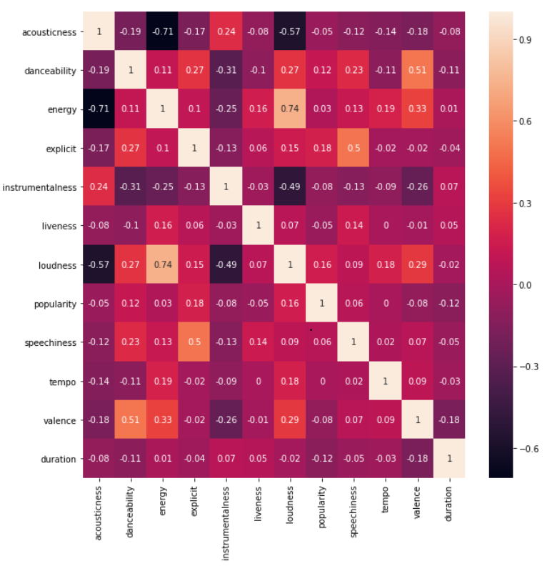
Correlation Matrix

Slide 11
Machine Learning
A combination of numeric variables, artist names, & words used in titles was used within ML models to predict song popularity scores
Coefficient values for every model can be seen within code
Models Used:
Linear Regression
Lasso
Ridge
Polynomial Regression
Random Forest Regression
Gradient Boosting Regression

Slide 12
Model Summary
Model | Training Set R^2 | Training Set RMSE | Testing Set R^2 | Testing Set RMSE
Standard Linear Regression w/ Only Numeric Variables | 10.81% | 11.05 | 10.76% | 11.04
Lasso Regression w/ Only Numeric Variables (alpha = 1e-08) | 10.81% | 11.05 | 10.76% | 11.04
Ridge Regression w/ Only Numeric Variables (alpha = .001) | 10.81% | 11.05 | 10.76% | 11.04
Polynomial Regression (degree = 2) | 18.38% | 10.57 | 17.89% | 10.59
Standard Linear Regression w/ Only Artist Names | 36.90% | 9.29 | -4.34% | 2.43639E+13
Lasso Regression w/ Only Artist Names | 36.27% | 9.34 | 29.33% | 9.83
Lasso Regression w/ Numeric Variables & Artist Names | 38.40% | 9.18 | 31.86% | 9.65
Lasso Regression w/ Only Words Used in Titles | 12.37% | 10.95 | 6.11% | 11.33
Lasso Regression w/ Numeric Variables, Artist Names, & Words Used in Titles | 42.50% | 8.87 | 31.87% | 9.65
Random Forest Regression w/ Only Numeric Variables | 17.02% | 10.66 | 16.52% | 10.68
Random Forest Regression w/ Numeric Variables, Artist Names, & Words Used in Titles | 17.39% | 10.63 | 16.38% | 10.69
Gradient Boosting Regression w/ Only Numeric Variables | 28.51% | 9.89 | 22.39% | 10.3
Gradient Boosting Regression w/ Numeric Variables, Artist Names, & Words Used in Titles | 30.05% | 9.78 | 25.51% | 10.09

Slide 13
Conclusions
The best performing model, a lasso regression model involving all of the variables, explained about 32% of the variance in popularity scores within the testing dataset
Able to predict popularity score with an RMSE of 9.65
Difficult to predict song popularity as music tastes/preferences of individuals can be very unique
More advanced & intricate models may need to be used to predict song popularity more accurately

